Slide 1
Linear Regression
Dr. Rashmi Mahajan

Slide 2
Recap: Machine learning algorithms
 | Supervised Learning | Unsupervised Learning
Discrete | Classification | Clustering
Continuous | Regression | Dimensionality reduction

Slide 3
Linear Regression
Model representation
Cost function
Gradient descent
Features and polynomial regression
Normal equation

Slide 4
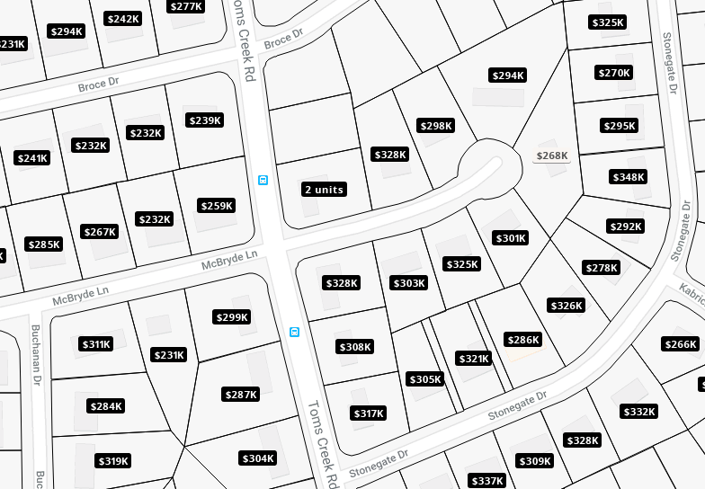

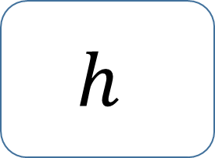
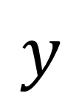
Regression
real-valued output
Training set
Learning Algorithm
$$h$$
$$x$$
$$y$$
Size of house
Hypothesis
Estimated price

Slide 5
House pricing prediction
Price ($) in 1000’s
400
300
200
100
500
1000
1500
2000
2500
Size in feet^2

Slide 6
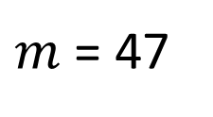


Training set
Size in feet^2 (x) | Price ($) in 1000’s (y)
2104 | 460
1416 | 232
1534 | 315
852 | 178
… | …
Notation:
$m$ = Number of training examples
$x$ = Input variable / features
$y$ = Output variable / target variable
($x$, $y$) = One training example
($x^{(i)}$, $y^{(i)}$) = $i^{th}$training example
$m$ = 47
Examples:
$x^{(1)}=$ $2104$
$x^{(2)}=$ $1416$
$y^{(1)}=$ $460$

Slide 7
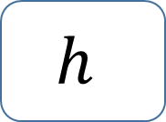



Model representation
$$y= h_{θ}\left(x\right)=θ_{0}+θ_{1}x$$
Shorthand $h\left(x\right)$
Training set
Learning Algorithm
Price ($) in 1000’s
400
300
$$x$$
$$h$$
$$y$$
200
100
Size of house
Hypothesis
Estimated price
500
1000
1500
2000
2500
Size in feet^2
Univariate linear regression

Slide 8
Linear Regression
Model representation
Cost function
Gradient descent
Features and polynomial regression
Normal equation

Slide 9
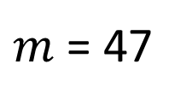
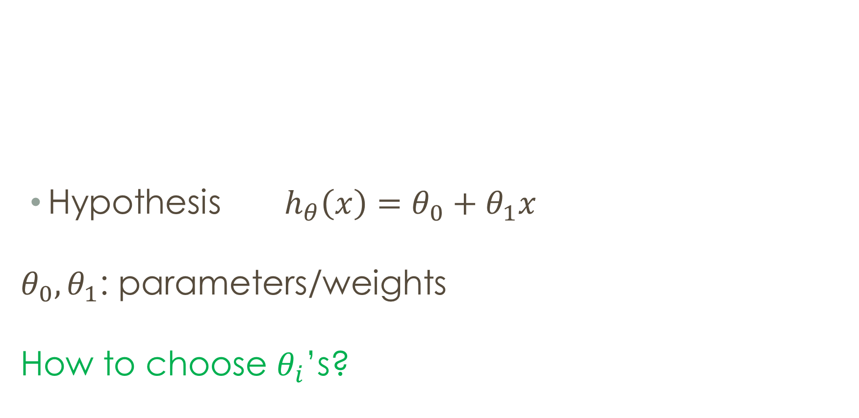
Training set
Size in feet^2 (x) | Price ($) in 1000’s (y)
2104 | 460
1416 | 232
1534 | 315
852 | 178
… | …
Hypothesis ${ h}_{θ}\left(x\right)=θ_{0}+θ_{1}x$
$θ_{0},θ_{1}$: parameters/weights
How to choose $θ_{i}$’s?
$m$ = 47

Slide 10

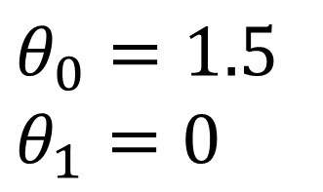




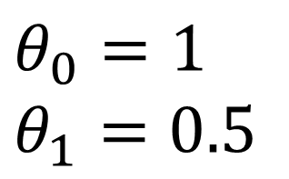

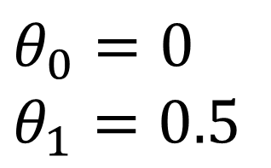

$$h_{θ}\left(x\right)=θ_{0}+θ_{1}x$$
$$y$$
$$y$$
$$y$$
3
3
3
2
2
2
1
1
1
1
2
3
$$x$$
1
2
3
$$x$$
1
2
3
$$x$$
$$θ_{0}=1.5$$
$$θ_{1}=0$$
$$θ_{0}=0$$
$$θ_{1}=0.5$$
$θ_{0}=1$
$$θ_{1}=0.5$$

Slide 11
$$h_{θ}\left(x\right)=θ_{0}+θ_{1}x$$
$$y$$
$$y$$
$$y$$
3
3
3
2
2
2
1
1
1
1
2
3
$$x$$
1
2
3
$$x$$
1
2
3
$$x$$
$$θ_{0}=1.5$$
$$θ_{1}=0$$
$$θ_{0}=0$$
$$θ_{1}=0.5$$
$θ_{0}=1$
$$θ_{1}=0.5$$

Slide 12
To reach cost function – least Square Estimate

Slide 13


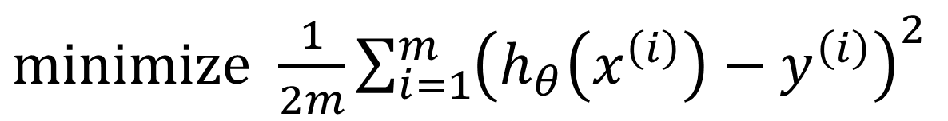
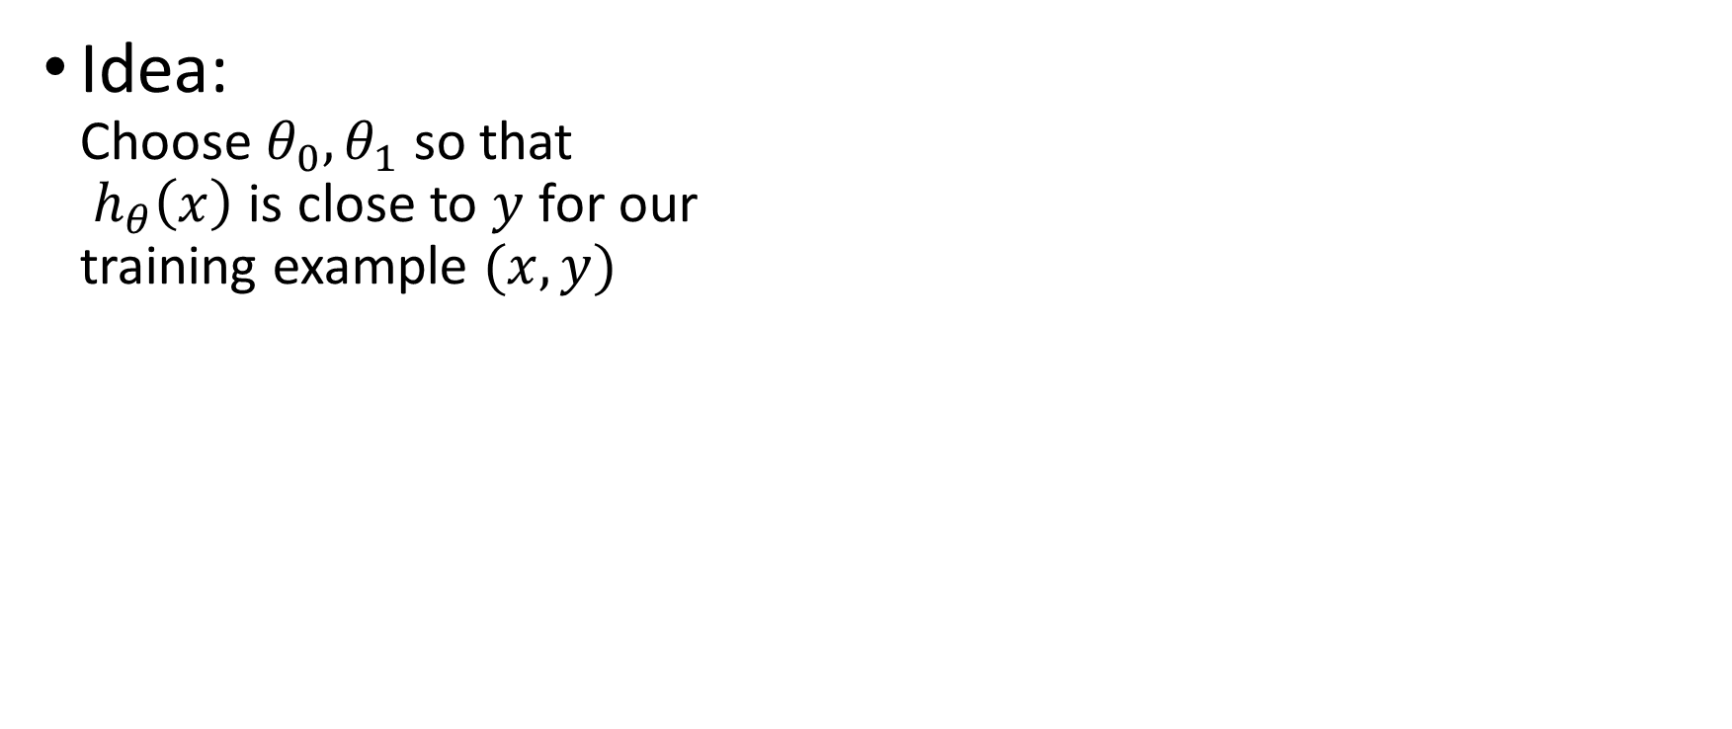
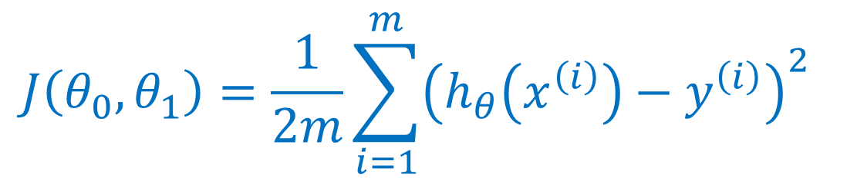
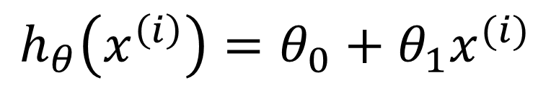


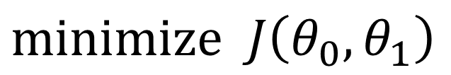
Cost function
$minimize$ $\frac{1}{2m}{\sum_{i=1}^{m}{\left(h_{θ}\left(x^{\left(i\right)}\right)−y^{\left(i\right)}\right)}}^{2}$
Idea: Choose $θ_{0},θ_{1}$ so that ${ h}_{θ}\left(x\right)$ is close to $y$ for our training example $(x,y)$
$$θ_{0},θ_{1}$$
$$h_{θ}\left(x^{\left(i\right)}\right)=θ_{0}+θ_{1}x^{(i)}$$
$$J\left(θ_{0}, θ_{1}\right)=\frac{1}{2m}\sum_{i=1}^{m}{{\left(h_{θ}\left(x^{\left(i\right)}\right)−y^{\left(i\right)}\right)}^{2}}$$
$$y$$
Price ($) in 1000’s
400
300
200
100
$minimize$ $J\left(θ_{0}, θ_{1}\right)$
Cost function
$$x$$
500
1000
1500
2000
2500
$$θ_{0},θ_{1}$$
Size in feet^2

Slide 14

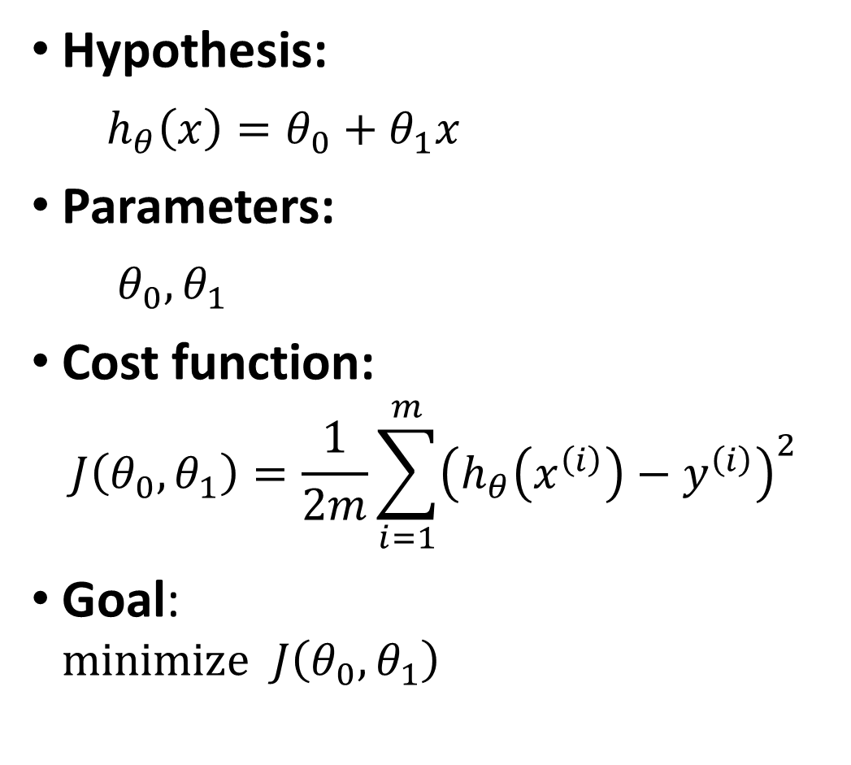

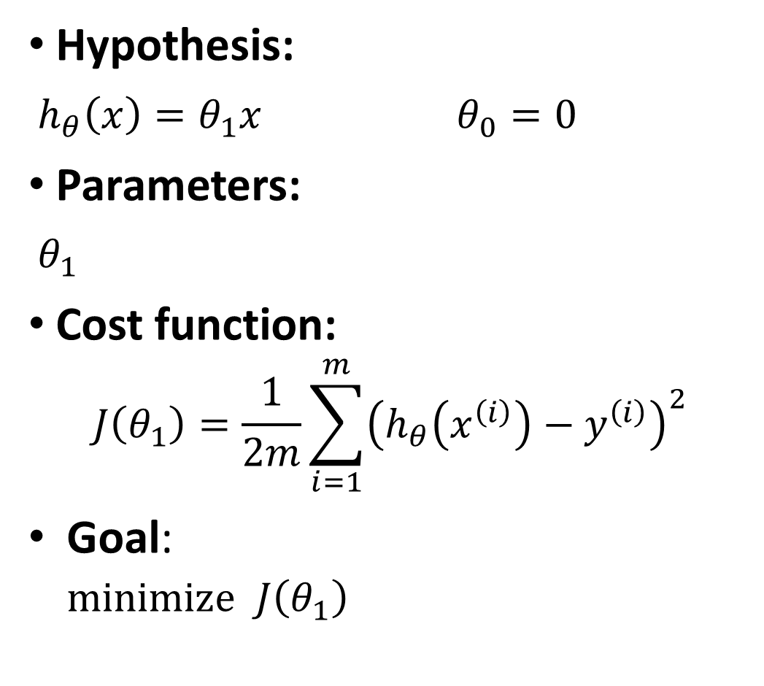
Simplified
Hypothesis:
$h_{θ}\left(x\right)=θ_{0}+θ_{1}x$
Parameters:
$θ_{0},θ_{1}$
Cost function:
$$J\left(θ_{0}, θ_{1}\right)=\frac{1}{2m}\sum_{i=1}^{m}{{\left(h_{θ}\left(x^{\left(i\right)}\right)−y^{\left(i\right)}\right)}^{2}}$$
Goal: $minimize$ $J\left(θ_{0}, θ_{1}\right)$
Hypothesis:
$h_{θ}\left(x\right)=θ_{1}x$ $θ_{0}=0$
Parameters:
$θ_{1}$
Cost function:
$$J\left(θ_{1}\right)=\frac{1}{2m}\sum_{i=1}^{m}{{\left(h_{θ}\left(x^{\left(i\right)}\right)−y^{\left(i\right)}\right)}^{2}}$$
Goal: $minimize$ $J\left(θ_{1}\right)$
$$θ_{0},θ_{1}$$
$$θ_{0},θ_{1}$$

Slide 15

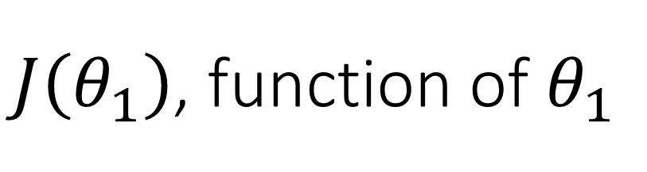
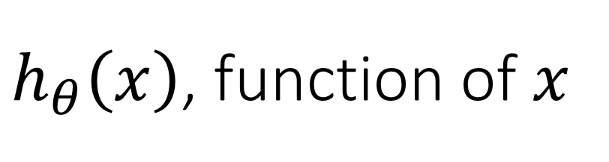



$h_{θ}\left(x\right)$, function of $x$
$J\left(θ_{1}\right)$, function of $θ_{1}$
$$y$$
$$J\left(θ_{1}\right)$$
3
3
2
2
1
1
$$x$$
$$θ_{1}$$
1
2
3
0
1
2
3

Slide 16
$h_{θ}\left(x\right)$, function of $x$
$J\left(θ_{1}\right)$, function of $θ_{1}$
$$y$$
$$J\left(θ_{1}\right)$$
3
3
2
2
1
1
$$x$$
$$θ_{1}$$
1
2
3
0
1
2
3

Slide 17
$h_{θ}\left(x\right)$, function of $x$
$J\left(θ_{1}\right)$, function of $θ_{1}$
$$y$$
$$J\left(θ_{1}\right)$$
3
3
2
2
1
1
$$x$$
$$θ_{1}$$
1
2
3
0
1
2
3

Slide 18
$h_{θ}\left(x\right)$, function of $x$
$J\left(θ_{1}\right)$, function of $θ_{1}$
$$y$$
$$J\left(θ_{1}\right)$$
3
3
2
2
1
1
$$x$$
$$θ_{1}$$
1
2
3
0
1
2
3

Slide 19
$h_{θ}\left(x\right)$, function of $x$
$J\left(θ_{1}\right)$, function of $θ_{1}$
$$y$$
$$J\left(θ_{1}\right)$$
3
3
2
2
1
1
$$x$$
$$θ_{1}$$
1
2
3
0
1
2
3

Slide 20

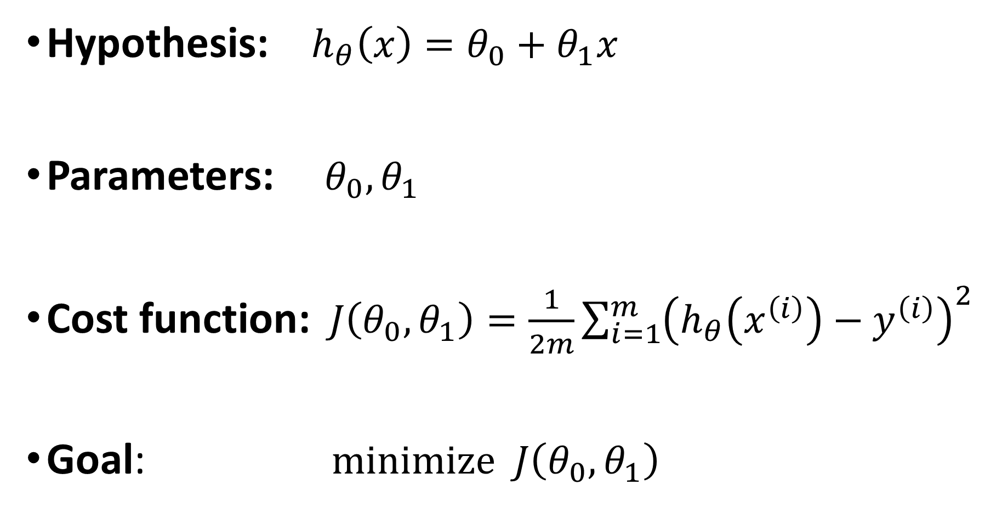
Hypothesis: $h_{θ}\left(x\right)=θ_{0}+θ_{1}x$
Parameters: $θ_{0},θ_{1}$
Cost function:$J\left(θ_{0}, θ_{1}\right)=\frac{1}{2m}\sum_{i=1}^{m}{{\left(h_{θ}\left(x^{\left(i\right)}\right)−y^{\left(i\right)}\right)}^{2}}$
Goal: $minimize$ $J\left(θ_{0}, θ_{1}\right)$
$$θ_{0},θ_{1}$$

Slide 21
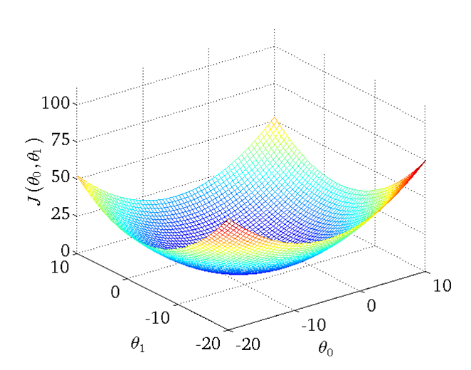
Cost function

Slide 22
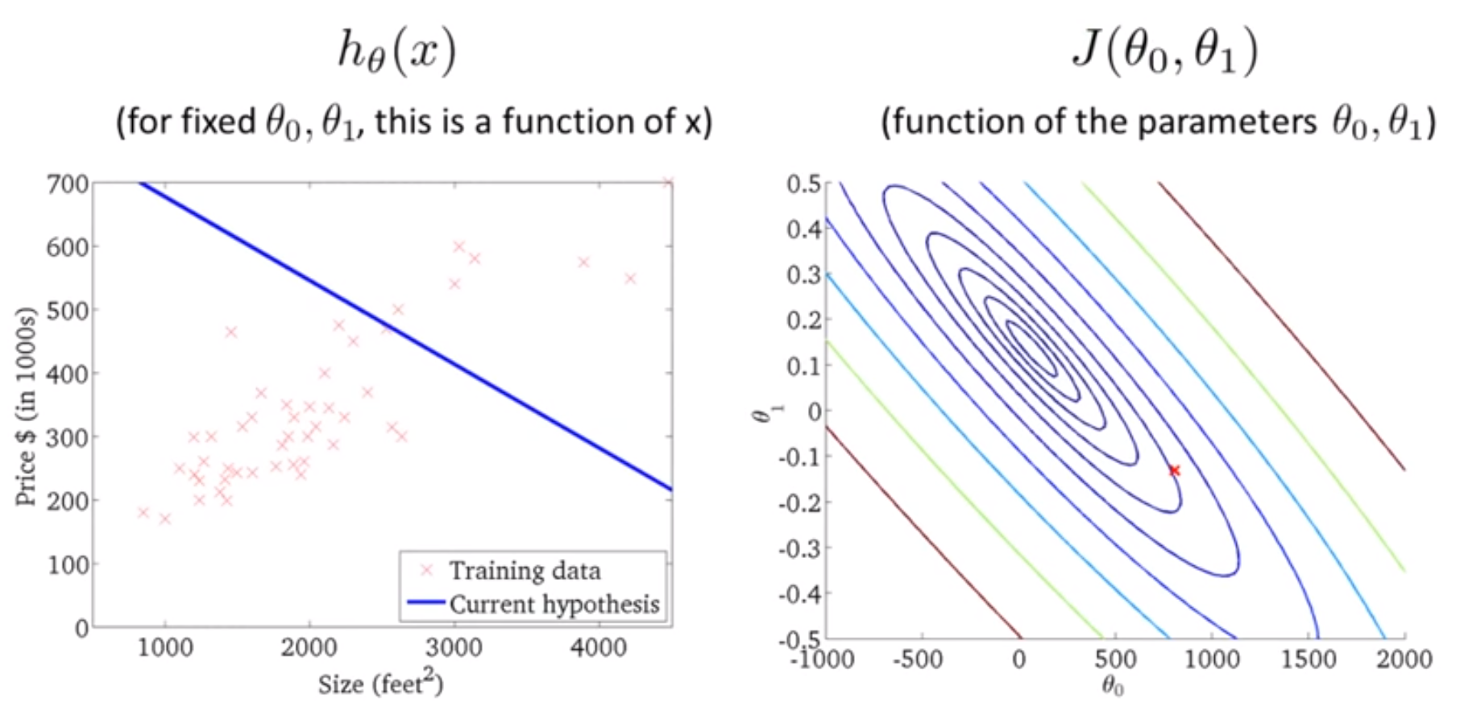
How do we find good $θ_{0},θ_{1}$ that minimize $J\left(θ_{0}, θ_{1}\right)$?

Slide 23
Linear Regression
Model representation
Cost function
Gradient descent
Features and polynomial regression
Normal equation

Slide 24

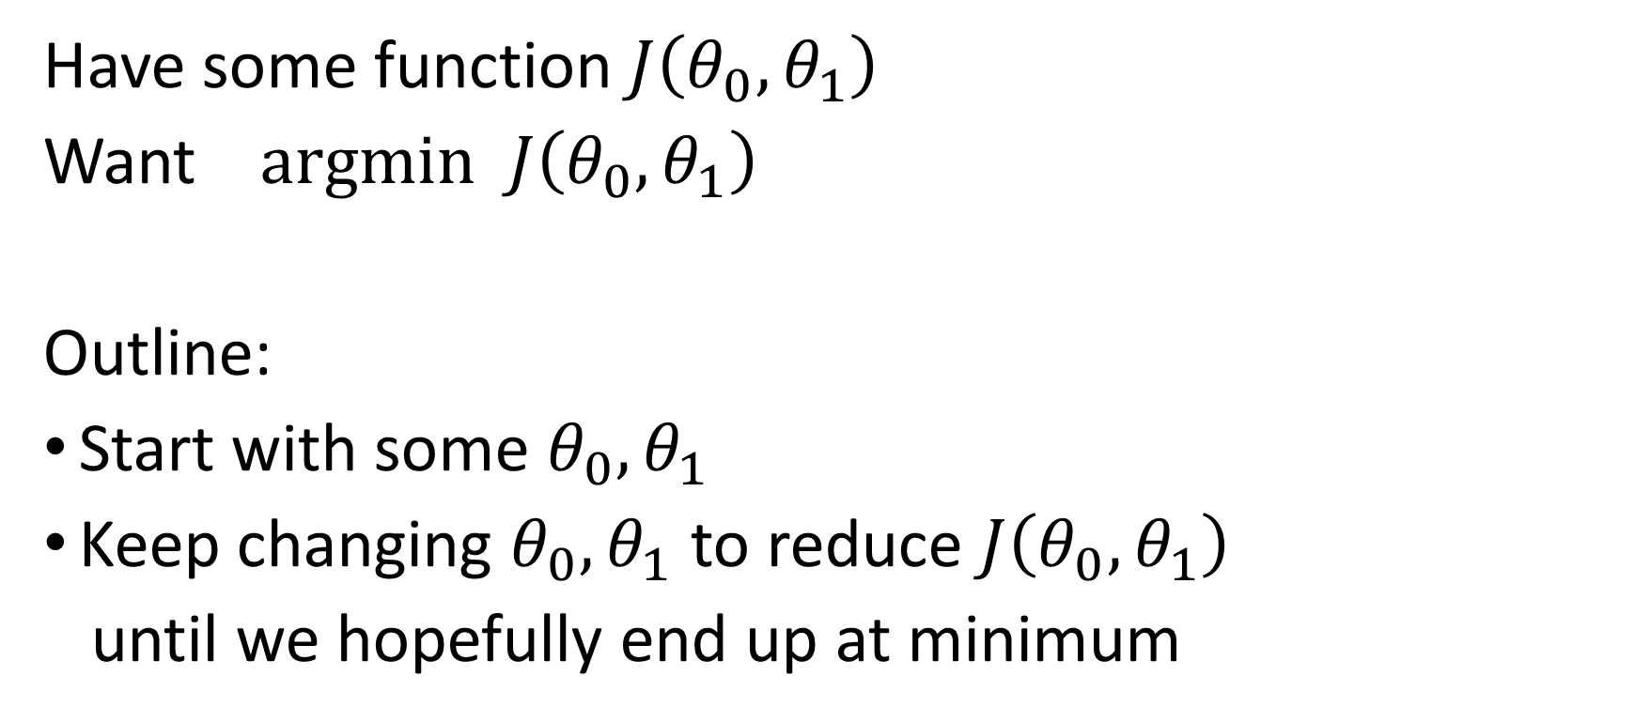
Gradient descent
Have some function $J\left(θ_{0}, θ_{1}\right)$
Want $argmin$ $J\left(θ_{0}, θ_{1}\right)$
Outline:
Start with some $θ_{0}, θ_{1}$
Keep changing $θ_{0}, θ_{1}$ to reduce $J\left(θ_{0}, θ_{1}\right)$
until we hopefully end up at minimum
$$θ_{0},θ_{1}$$

Slide 25
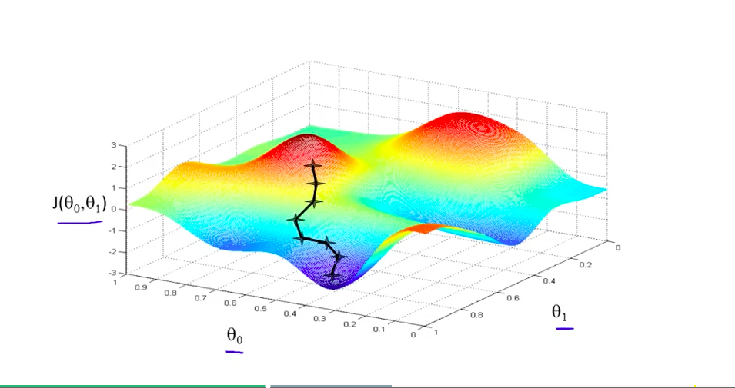

Slide 26
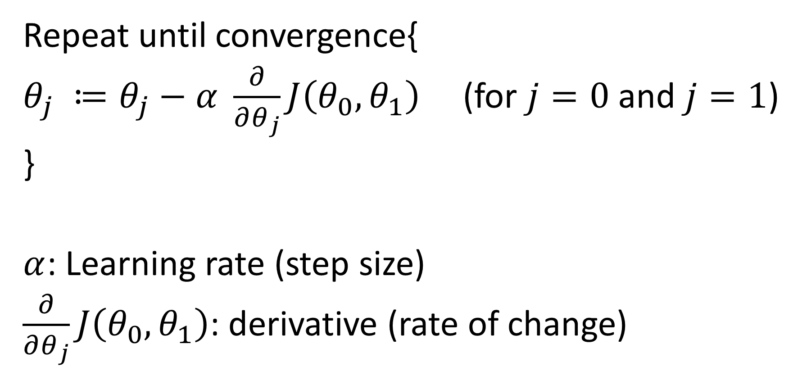
Gradient descent
Repeat until convergence{
$θ_{j} ≔θ_{j}−α \frac{∂}{∂θ_{j}}J\left(θ_{0}, θ_{1}\right)$ (for $j=0$ and $j=1$)
}
$α$: Learning rate (step size)
$\frac{∂}{∂θ_{j}}J\left(θ_{0}, θ_{1}\right)$: derivative (rate of change)

Slide 27
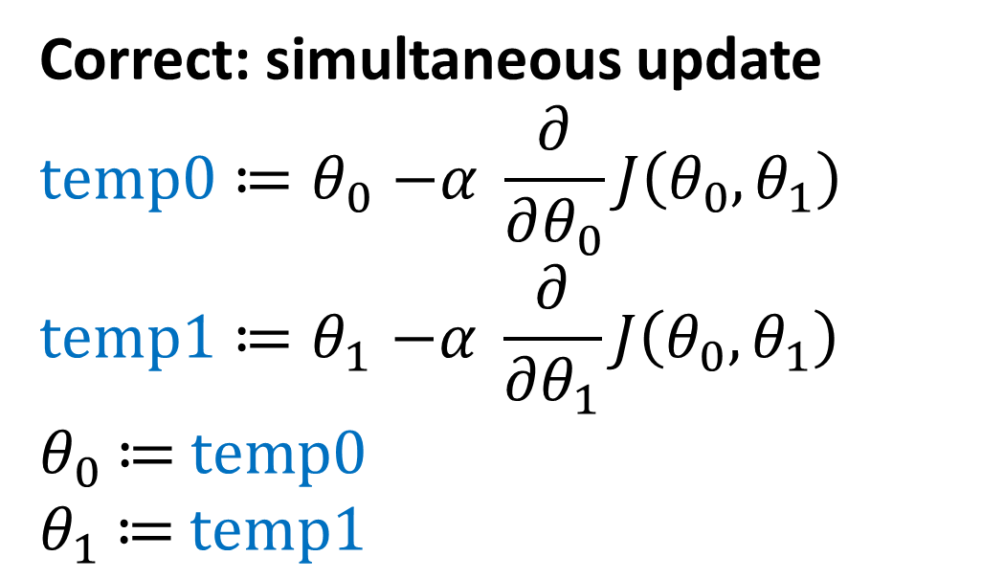
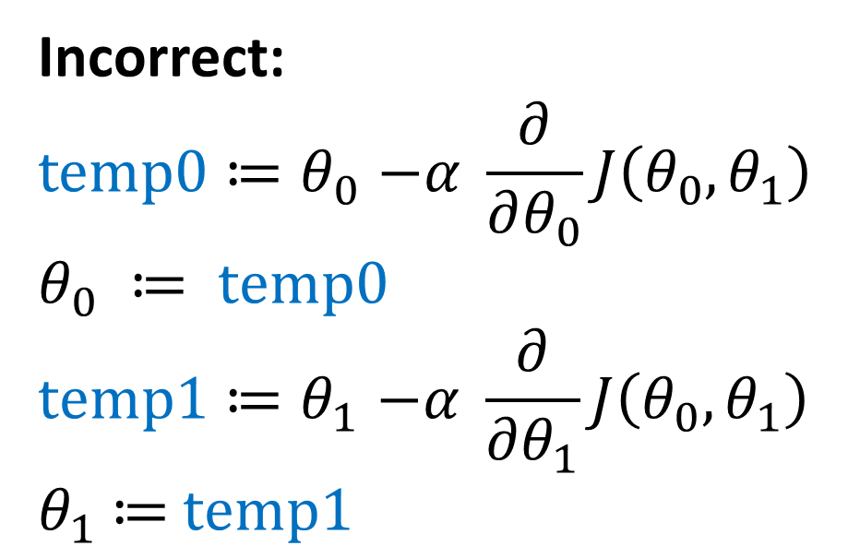
Gradient descent
Correct: simultaneous update
$$temp0{≔θ}_{0}−α \frac{∂}{∂θ_{0}}J\left(θ_{0}, θ_{1}\right)$$
$$temp1{≔θ}_{1}−α \frac{∂}{∂θ_{1}}J\left(θ_{0}, θ_{1}\right)$$
$θ_{0}$ $≔$ $temp0$
$θ_{1}$ $≔$ $temp1$
Incorrect:
$$temp0{≔θ}_{0}−α \frac{∂}{∂θ_{0}}J\left(θ_{0}, θ_{1}\right)$$
$$θ_{0} ≔ temp0$$
$$temp1{≔θ}_{1}−α \frac{∂}{∂θ_{1}}J\left(θ_{0}, θ_{1}\right)$$
$θ_{1}$ $≔$ $temp1$

Slide 28
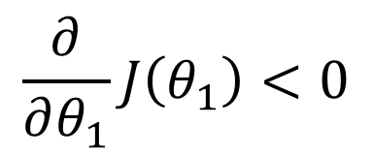

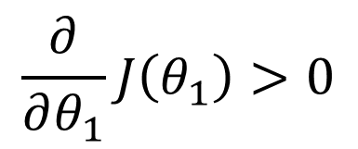

$$θ_{1} ≔θ_{1}−α \frac{∂}{∂θ_{1}}J\left(θ_{1}\right)$$
$$J\left(θ_{1}\right)$$
$$\frac{∂}{∂θ_{1}}J\left(θ_{1}\right)<0$$
3
$$\frac{∂}{∂θ_{1}}J\left(θ_{1}\right)>0$$
2
1
$$θ_{1}$$
0
1
2
3

Slide 29
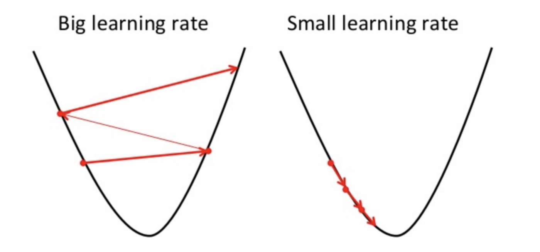
Learning rate

Slide 30
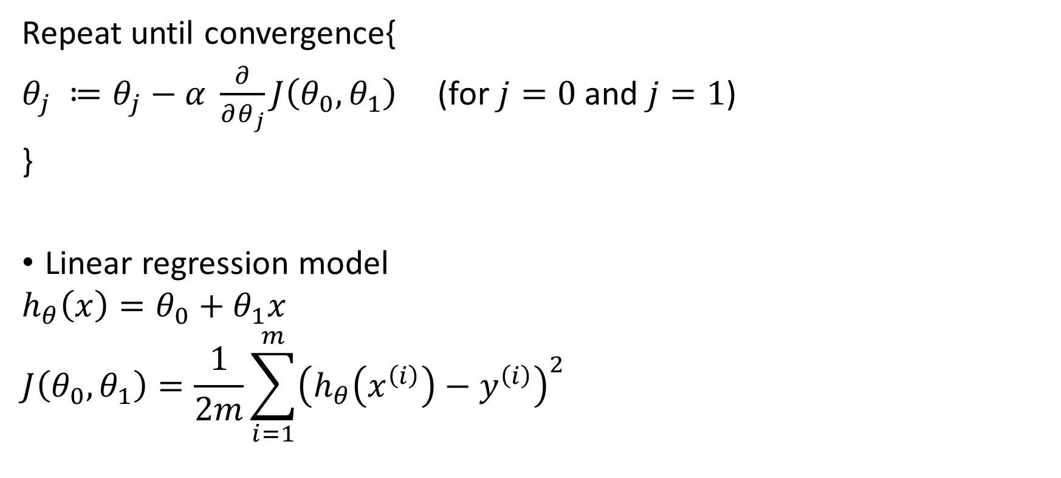
Gradient descent for linear regression
Repeat until convergence{
$θ_{j} ≔θ_{j}−α \frac{∂}{∂θ_{j}}J\left(θ_{0}, θ_{1}\right)$ (for $j=0$ and $j=1$)
}
Linear regression model
$$h_{θ}\left(x\right)=θ_{0}+θ_{1}x$$
$$J\left(θ_{0}, θ_{1}\right)=\frac{1}{2m}\sum_{i=1}^{m}{{\left(h_{θ}\left(x^{\left(i\right)}\right)−y^{\left(i\right)}\right)}^{2}}$$

Slide 31
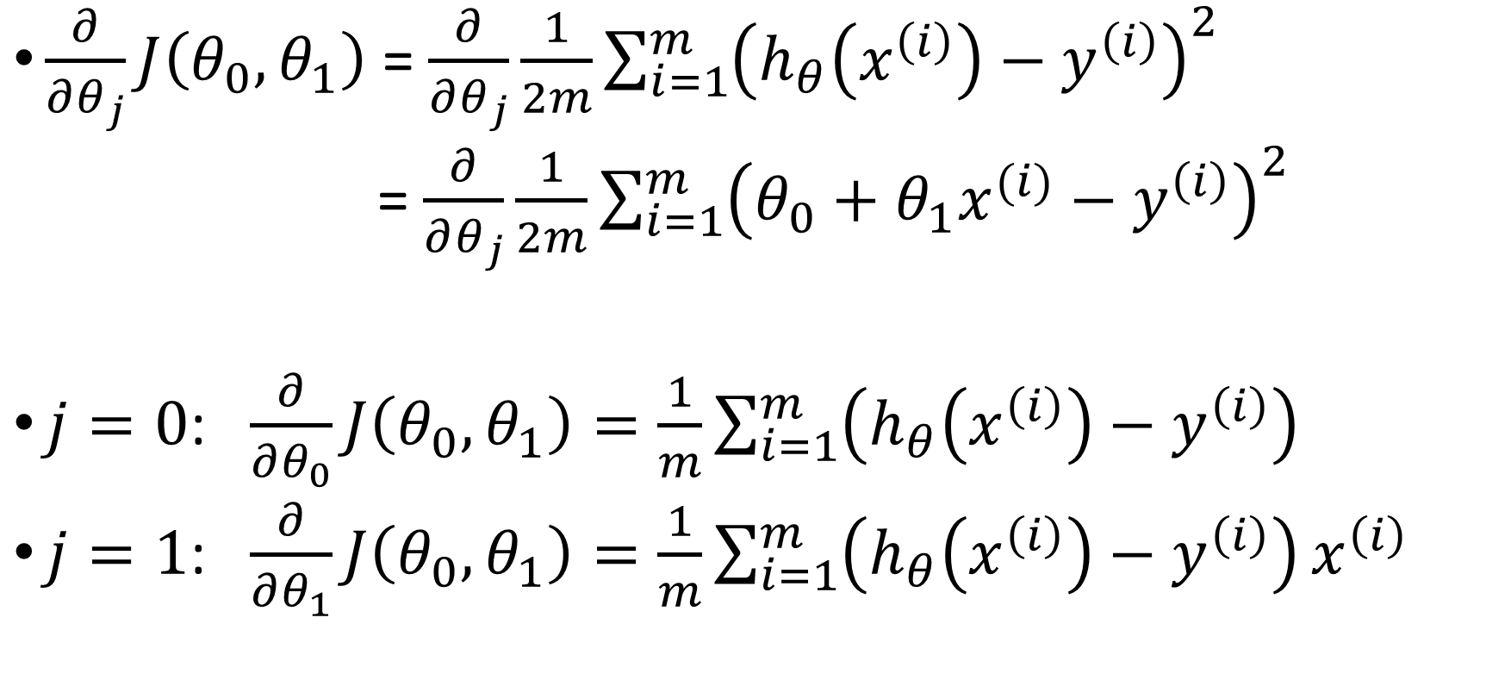
Computing partial derivative
$\frac{∂}{∂θ_{j}}J\left(θ_{0}, θ_{1}\right)$ = $\frac{∂}{∂θ_{j}}\frac{1}{2m}\sum_{i=1}^{m}{{\left(h_{θ}\left(x^{\left(i\right)}\right)−y^{\left(i\right)}\right)}^{2}}$
= $\frac{∂}{∂θ_{j}}\frac{1}{2m}\sum_{i=1}^{m}{{\left(θ_{0}+θ_{1}x^{(i)}−y^{\left(i\right)}\right)}^{2}}$
$j=0$: $\frac{∂}{∂θ_{0}}J\left(θ_{0}, θ_{1}\right)=\frac{1}{m}\sum_{i=1}^{m}{\left(h_{θ}\left(x^{\left(i\right)}\right)−y^{\left(i\right)}\right)}$
$j=1$: $\frac{∂}{∂θ_{1}}J\left(θ_{0}, θ_{1}\right)=\frac{1}{m}\sum_{i=1}^{m}{\left(h_{θ}\left(x^{\left(i\right)}\right)−y^{\left(i\right)}\right)}x^{\left(i\right)}$

Slide 32
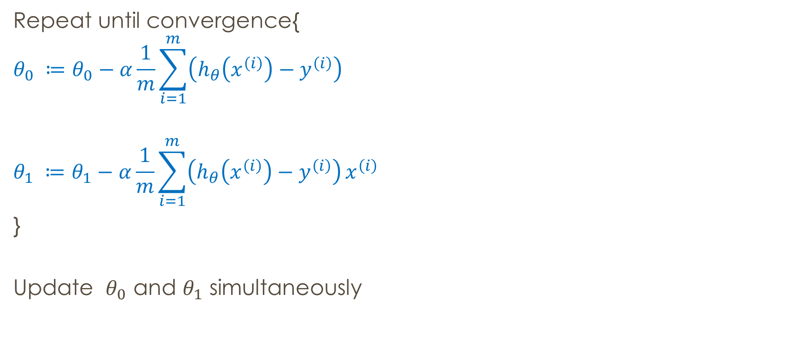
Gradient descent for linear regression
Repeat until convergence{
$$θ_{0} ≔θ_{0}−α\frac{1}{m}\sum_{i=1}^{m}{\left(h_{θ}\left(x^{\left(i\right)}\right)−y^{\left(i\right)}\right)}$$
$$θ_{1} ≔θ_{1}−α\frac{1}{m}\sum_{i=1}^{m}{\left(h_{θ}\left(x^{\left(i\right)}\right)−y^{\left(i\right)}\right)}x^{\left(i\right)}$$
}
Update $θ_{0}$ and $θ_{1}$ simultaneously

Slide 33
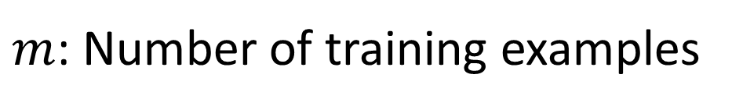
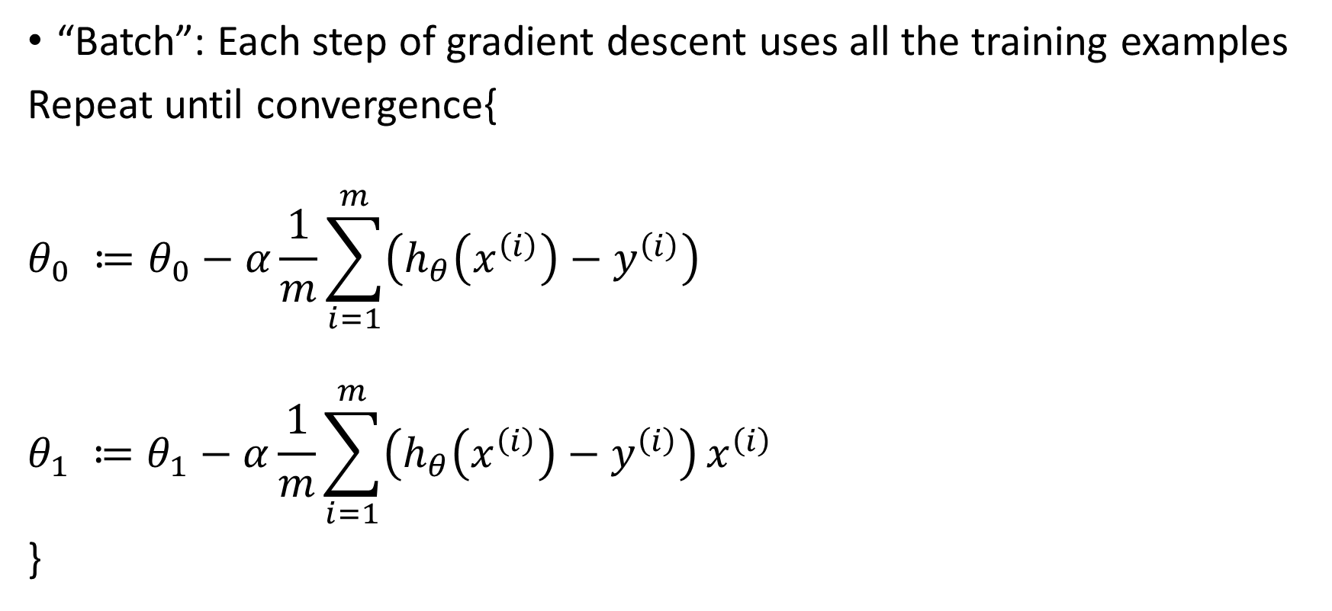
Batch gradient descent
“Batch”: Each step of gradient descent uses all the training examples
Repeat until convergence{
$$θ_{0} ≔θ_{0}−α\frac{1}{m}\sum_{i=1}^{m}{\left(h_{θ}\left(x^{\left(i\right)}\right)−y^{\left(i\right)}\right)}$$
$$θ_{1} ≔θ_{1}−α\frac{1}{m}\sum_{i=1}^{m}{\left(h_{θ}\left(x^{\left(i\right)}\right)−y^{\left(i\right)}\right)}x^{\left(i\right)}$$
}
$m$: Number of training examples

Slide 34
Linear Regression
Model representation
Cost function
Gradient descent
Features and polynomial regression
Normal equation

Slide 35

Training dataset
Size in feet^2 (x) | Price ($) in 1000’s (y)
2104 | 460
1416 | 232
1534 | 315
852 | 178
… | …
$$h_{θ}\left(x\right)=θ_{0}+θ_{1}x$$

Slide 36
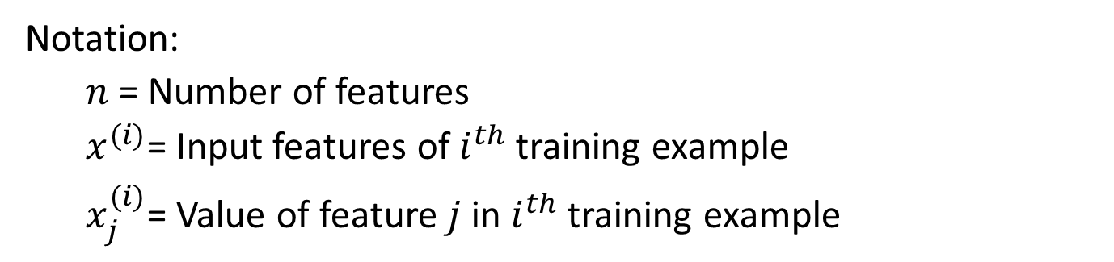
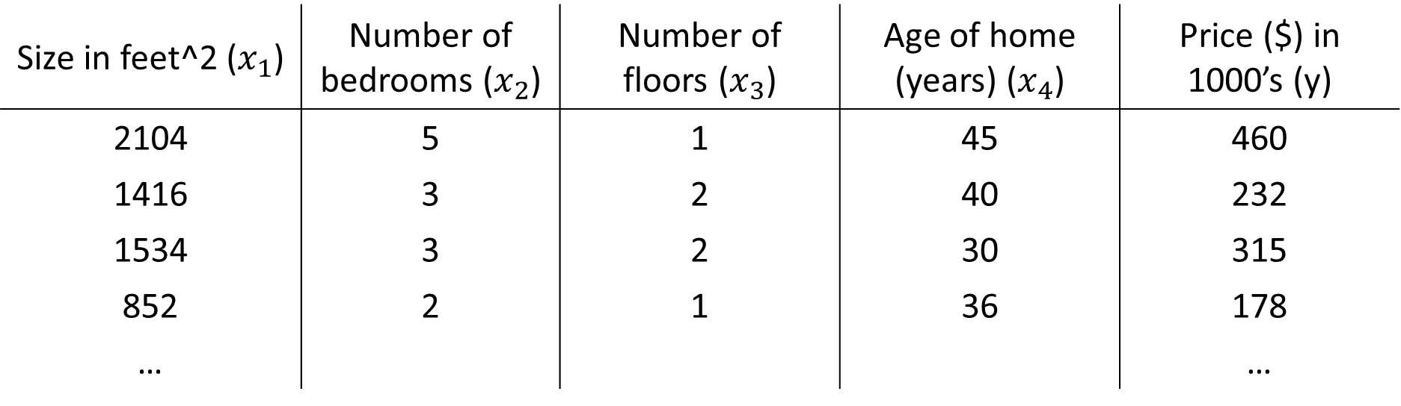

Multiple features (input variables)
Size in feet^2 ($x_{1}$) | Number of bedrooms ($x_{2}$) | Number of floors ($x_{3}$) | Age of home (years) ($x_{4}$) | Price ($) in 1000’s (y)
2104 | 5 | 1 | 45 | 460
1416 | 3 | 2 | 40 | 232
1534 | 3 | 2 | 30 | 315
852 | 2 | 1 | 36 | 178
… |  |  |  | …
Notation:
$n$ = Number of features
$x^{(i)}$= Input features of $i^{th}$training example
$x_{j}^{(i)}$= Value of feature $j$ in $i^{th}$training example
$$x_{3}^{(2)}=?$$
$$x_{3}^{(4)}=?$$

Slide 37

Hypothesis
Previously: $h_{θ}\left(x\right)=θ_{0}+θ_{1}x$
Now: $h_{θ}\left(x\right)=θ_{0}+θ_{1}x_{1}+θ_{2}x_{2}{+θ}_{3}x_{3}+θ_{4}x_{4}$

Slide 38
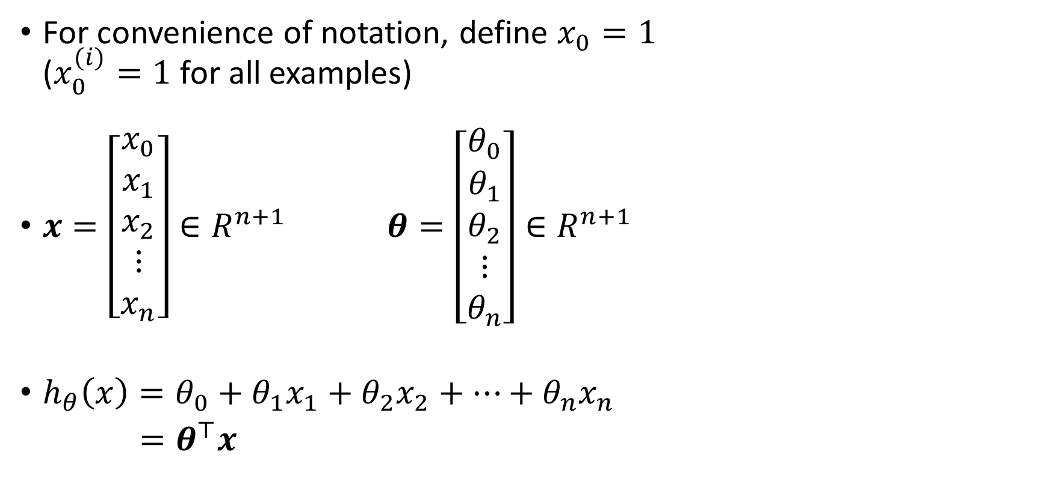
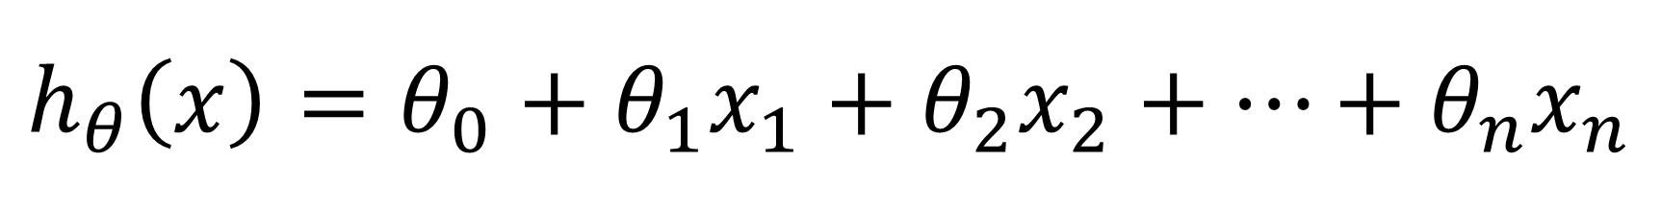
$$h_{θ}\left(x\right)=θ_{0}+θ_{1}x_{1}+θ_{2}x_{2}+…+θ_{n}x_{n}$$
For convenience of notation, define $x_{0}=1$ ($x_{0}^{(i)}=1$ for all examples)
$x=\left[\begin{aligned}x_{0} \\ x_{1} \\ x_{2} \\ ⋮ \\ x_{n}\end{aligned}\right]∈R^{n+1}$ $θ=\left[\begin{aligned}θ_{0} \\ θ_{1} \\ θ_{2} \\ ⋮ \\ θ_{n}\end{aligned}\right]∈R^{n+1}$
$h_{θ}\left(x\right)=θ_{0}+θ_{1}x_{1}+θ_{2}x_{2}+…+θ_{n}x_{n}$
$=θ^{⊤}x$

Slide 39
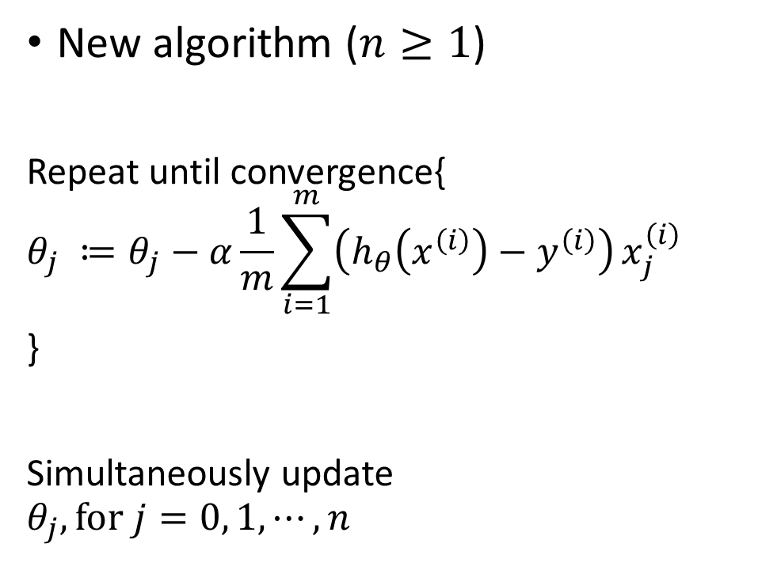
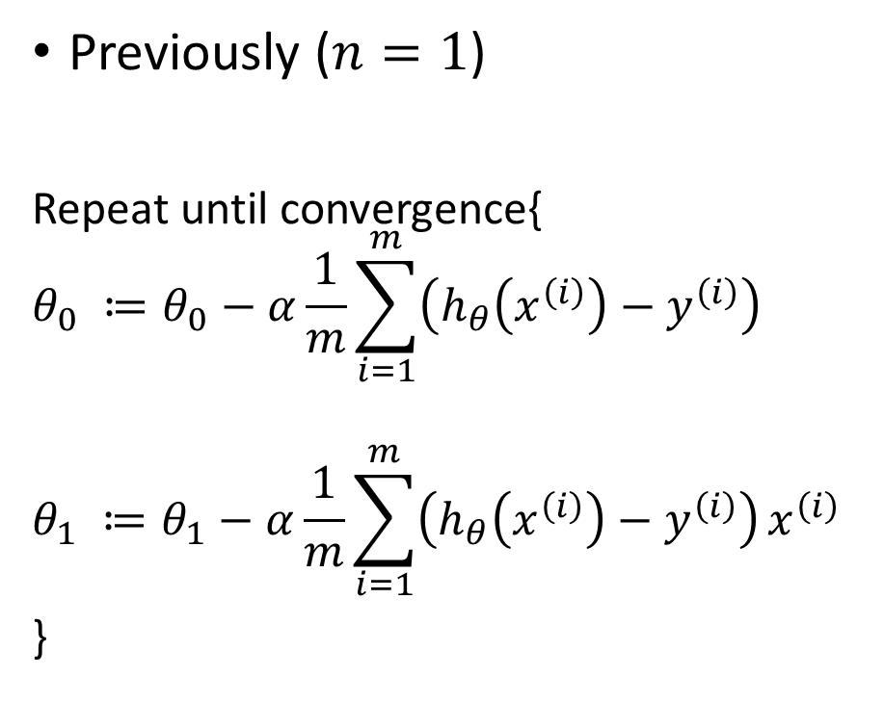
Gradient descent
Previously ($n=1$)
Repeat until convergence{
$$θ_{0} ≔θ_{0}−α\frac{1}{m}\sum_{i=1}^{m}{\left(h_{θ}\left(x^{\left(i\right)}\right)−y^{\left(i\right)}\right)}$$
$$θ_{1} ≔θ_{1}−α\frac{1}{m}\sum_{i=1}^{m}{\left(h_{θ}\left(x^{\left(i\right)}\right)−y^{\left(i\right)}\right)}x^{\left(i\right)}$$
}
New algorithm ($n≥1$)
Repeat until convergence{
$$θ_{j} ≔θ_{j}−α\frac{1}{m}\sum_{i=1}^{m}{\left(h_{θ}\left(x^{\left(i\right)}\right)−y^{\left(i\right)}\right)}x_{j}^{\left(i\right)}$$
}
Simultaneously update
$$θ_{j}, for j=0, 1, ⋯,n$$

Slide 40


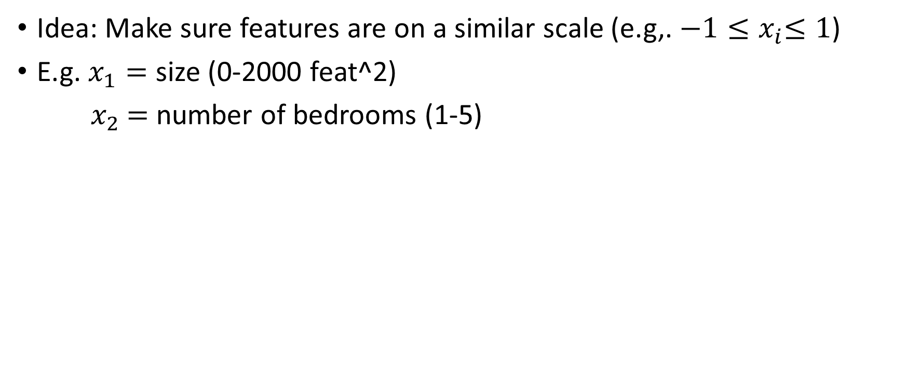
Gradient descent in practice: Feature scaling
Idea: Make sure features are on a similar scale (e.g,. ${−1≤x}_{i}≤1$)
E.g. $x_{1}=$ size (0-2000 feat^2)
${ x}_{2} =$ number of bedrooms (1-5)
$$θ_{2}$$
$$θ_{2}$$
3
3
2
2
1
1
$$θ_{1}$$
0
1
2
3
$$θ_{1}$$
0
1
2
3

Slide 41
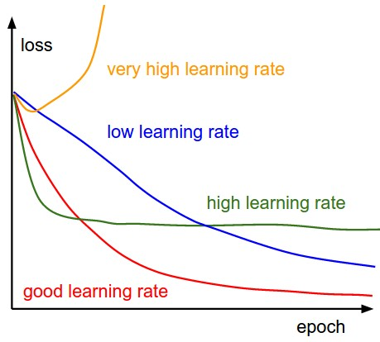
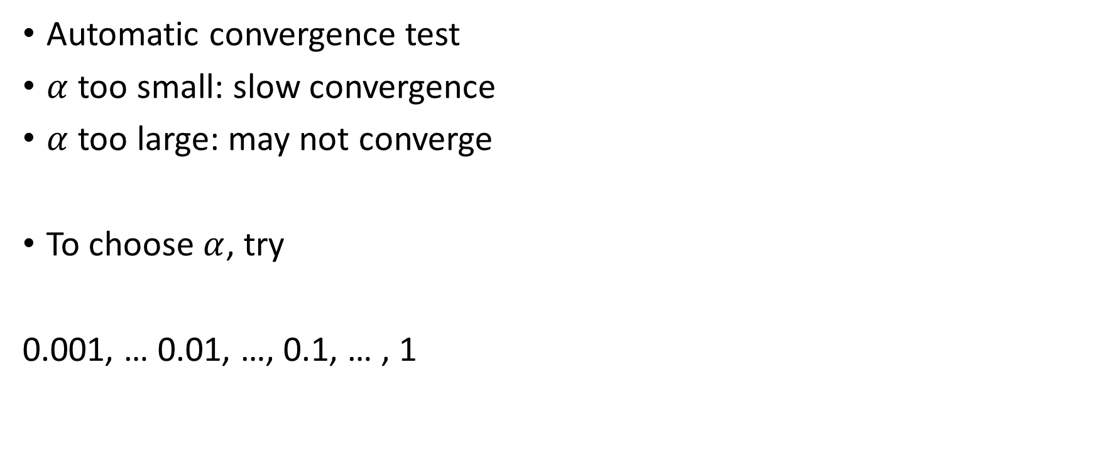
Gradient descent in practice: Learning rate
Automatic convergence test
$α$ too small: slow convergence
$α$ too large: may not converge
To choose $α$, try
0.001, … 0.01, …, 0.1, … , 1

Slide 42
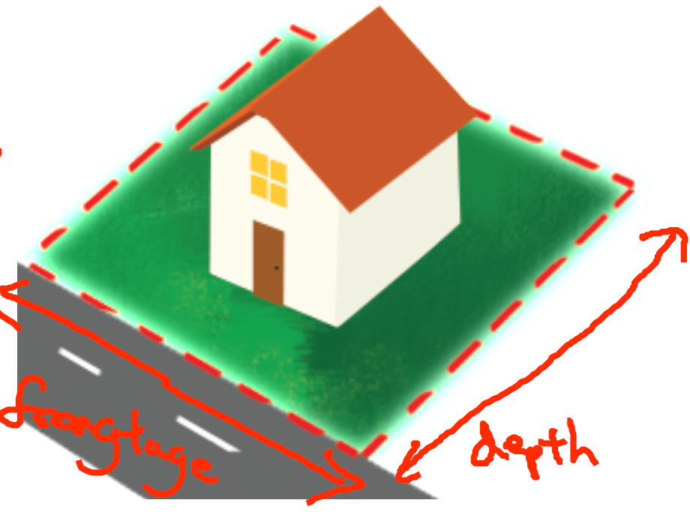

House prices prediction
$h_{θ}\left(x\right)=θ_{0}+θ_{1}×frontage+θ_{2}×depth$
Area $x= frontage×depth$
$h_{θ}\left(x\right)=θ_{0}+θ_{1}x$

Slide 43


Polynomial regression
$h_{θ}\left(x\right)=θ_{0}+θ_{1}x_{1}+θ_{2}x_{2}+θ_{3}x_{3}$
$=θ_{0}+θ_{1}\left(size\right)+θ_{2}{\left(size\right)}^{2}+θ_{3}{\left(size\right)}^{3}$
Price ($) in 1000’s
400
300
200
$x_{1}$ = (size)
$x_{2}$ = (size)^2
$x_{3}$ = (size)^3
100
500
1000
1500
2000
2500
Size in feet^2

Slide 44
Linear Regression
Model representation
Cost function
Gradient descent
Features and polynomial regression
Normal equation

Slide 45




($x_{0}$) | Size in feet^2 ($x_{1}$) | Number of bedrooms ($x_{2}$) | Number of floors ($x_{3}$) | Age of home (years) ($x_{4}$) | Price ($) in 1000’s (y)
1 | 2104 | 5 | 1 | 45 | 460
1 | 1416 | 3 | 2 | 40 | 232
1 | 1534 | 3 | 2 | 30 | 315
1 | 852 | 2 | 1 | 36 | 178
 | … |  |  |  | …
$$y=\left[\begin{aligned}460 \\ 232 \\ 315 \\ 178\end{aligned}\right]$$
$$θ={(X^{⊤}X)}^{−1}X^{⊤}y$$

Slide 46

Least square solution
$J\left(θ\right)=\frac{1}{2m}\sum_{i=1}^{m}{{\left(h_{θ}\left(x^{\left(i\right)}\right)−y^{\left(i\right)}\right)}^{2}}$ $=\frac{1}{2m}\sum_{i=1}^{m}{{\left(θ^{⊤}x^{(i)}−y^{\left(i\right)}\right)}^{2}}$ $=$ $\frac{1}{2m}{\left\|Xθ−y\right\|}_{2}^{2}$
$\frac{∂}{∂θ}J\left(θ\right)=0$
$θ={(X^{⊤}X)}^{−1}X^{⊤}y$

Slide 47

Justification/interpretation 1
Loss minimization
$$J\left(θ\right)=\frac{1}{2m}\sum_{i=1}^{m}{{\left(h_{θ}\left(x^{\left(i\right)}\right)−y^{\left(i\right)}\right)}^{2}}=\frac{1}{m}\sum_{i=1}^{m}{L_{ls}\left(h_{θ}\left(x^{\left(i\right)}\right), y^{\left(i\right)}\right)}$$
$L_{ls}\left(y, \hat{y}\right)=\frac{1}{2}{\left\|y −\hat{y}\right\|}_{2}^{2}:$Least squares loss
Empirical Risk Minimization (ERM)
$$\frac{1}{m}\sum_{i=1}^{m}{L_{ls}\left(y^{\left(i\right)}, \hat{y}\right)}$$

Slide 48


Justification/interpretation 2
Probabilistic model
Assume linear model with Gaussian errors
$$p_{θ}\left(y^{\left(i\right)} | x^{\left(i\right)}\right)=\frac{1}{\sqrt{2πσ^{2}}}exp⁡(−\frac{1}{2σ^{2}}(y^{\left(i\right)}−θ^{⊤}x^{\left(i\right)})$$
Solving maximum likelihood
$$\underset{θ}{argmin}{\prod_{i=1}^{m}{p_{θ}\left(y^{\left(i\right)} | x^{\left(i\right)}\right)}}$$
$$\underset{θ}{argmin}{log⁡(\prod_{i=1}^{m}{p\left(y^{\left(i\right)} | x^{\left(i\right)}\right)})}=\underset{θ}{argmin} \frac{1}{2σ^{2}}\sum_{i=1}^{m}{\frac{1}{2}{\left(θ^{⊤}x^{\left(i\right)}−y^{\left(i\right)}\right)}^{2}}$$

Slide 49





Justification/interpretation 3
$$y$$
$$Xθ−y$$
Geometric interpretation
$$X= \left[\begin{matrix}1 & ←x^{(1)}→ \\ \begin{aligned}1 \\ ⋮ \\ 1\end{aligned} & \begin{aligned}←x^{(2)}→ \\ ⋮ \\ ←x^{(m)}→\end{aligned}\end{matrix}\right]=\left[\begin{aligned}{\begin{aligned}↑ \\ z\end{aligned}}_{0} {\begin{aligned}↑ \\ z\end{aligned}}_{1} {\begin{aligned}↑ \\ z\end{aligned}}_{2} ⋯ {\begin{aligned}↑ \\ z\end{aligned}}_{n} \\ ↓ ↓ ↓ ↓ \end{aligned}\right]$$
$Xθ$: column space of $X$ or span($\{z_{0}, z_{1}, ⋯, z_{n}\}$)
Residual $Xθ−y$ is orthogonal to the column space of $X$
$X^{⊤}\left(Xθ−y\right)=0→{(X}^{⊤}X)θ=X^{⊤}y$
$$Xθ$$
column space of $X$

Slide 50



$m$ training examples, $n$ features
Gradient Descent
Need to choose $α$
Need many iterations
Works well even when $n$ is large
Normal Equation
No need to choose $α$
Don’t need to iterate
Need to compute ${(X^{⊤}X)}^{−1}$
Slow if $n$ is very large

Slide 51

Things to remember
Model representation
$$h_{θ}\left(x\right)=θ_{0}+θ_{1}x_{1}+θ_{2}x_{2}+…+θ_{n}x_{n}=θ^{⊤}x$$
Cost function $J\left(θ\right)=\frac{1}{2m}\sum_{i=1}^{m}{{\left(h_{θ}\left(x^{\left(i\right)}\right)−y^{\left(i\right)}\right)}^{2}}$
Gradient descent for linear regression Repeat until convergence {$θ_{j} ≔θ_{j}−α\frac{1}{m}\sum_{i=1}^{m}{\left(h_{θ}\left(x^{\left(i\right)}\right)−y^{\left(i\right)}\right)}x_{j}^{\left(i\right)}$}
Features and polynomial regression
Can combine features; can use different functions to generate features (e.g., polynomial)
Normal equation $θ={(X^{⊤}X)}^{−1}X^{⊤}y$

Slide 52
Next
Naïve Bayes, Logistic regression, Regularization

